Slide 1



Tailoring Light-Matter Interaction in Nanophotonic Environments
Petru Tighineanu
Quantum Photonics group
August 27, 2012

Slide 2
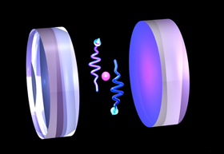
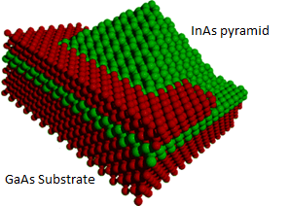
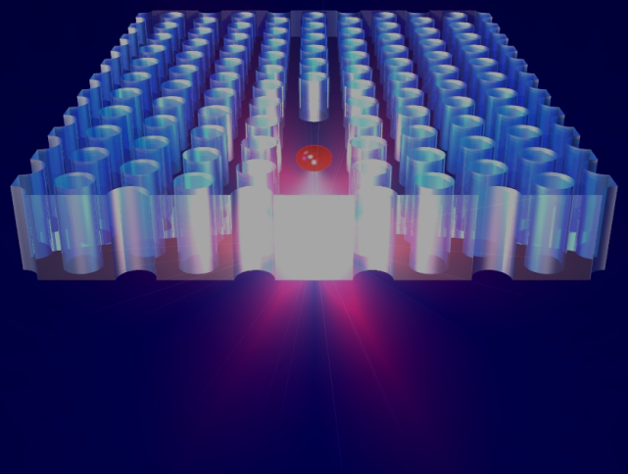
Motivation
In quantum optics we often desire STRONG light-matter interaction.
Energy
The implementation of quantum optics in nanophotonics.
Energy
Notes:
In QO, we often need strong coupling between an emitter light. Unfortunately, atoms normally have a limited intrinsic coupling to the EM field and, therefore, extremely high-finesse cavities are required to achieve the strong coupling regime.
In this regard, nanophotonics provides a solution to this problem by using emitters comprising MANY atoms. For example, a semiconductor QD represents a collection of atoms of a certain material (e.g., InAs) grown and embedded in a material with a larger band gap (e.g., GaAs). It turns out the spectrum of QDs is also discrete, however the transitions normally benefit from an enhanced coupling to light. Aside from this, a QD can be tailored in almost any way you want (size, shape, material composition) to match our needs.
There are many further advantages and disadvantages QDs, however I won’t bore you with them. However, there is another side of the story: even though considerable theoretical efforts have been made so far, QDs are still very poorly understood. The main reason for this is that there is a huge number of atoms which comprise the QD (over 10k), and the multi-particle Schrödinger equation becomes unfeasible to solve. Therefore, one has to rely on approximations which may or may not reproduce the experimental results. This lack of knowledge about QDs and their interaction with light has motivated me to pursue a PhD in quantum photonics.

Slide 3
Outline of the talk
We will address two basic questions:
How strongly are QDs capable of coupling to the light field?
To which extent do QDs behave as point-like sources?
Notes:
Therefore, this talk will be about the physics of QDs. We will see the main consequences of the fact that QDs are extended emitters and not point-like sources. First, we will try to see how strongly can QDs couple to the light field. Second, we will see whether or not QDs behave like dipoles when interacting with light, an approximation which has been considered rock solid.

Slide 4






Small QDs
Dimensional confinement
Coulomb confinement
Notes:
So far, people have mostly worked with small QDs because they are easy to grow and they are versatile. By “small” I mean QDs where dimensional (or quantum) confinement is strong or, alternatively, QDs smaller than the exciton Bohr radius. In such systems excitonic effects are smaller than confinement effects since they scale differently. Therefore, we can neglect the electron-hole Coulomb attraction in the 1st approximation.
In the effective mass approximation, we write the conduction and valence band wavefunctions as a product of a periodic unit cell and a slowly varying envelope. Then, by plugging this into Fermi’s Golden Rule, one can show that the OS, which is the figure of merit of the strength of light-matter interaction, is given by the matrix element between conduction and valence band periodic functions, which is constant, and the overlap of the slowly-varying envelopes, which is a value of the order of unity. In other words, the OS does not depend on the dot size.

Slide 5

Large QDs
Dimensional confinement
Coulomb confinement
Notes:
Things change considerably when we investigate large QDs.

Slide 6
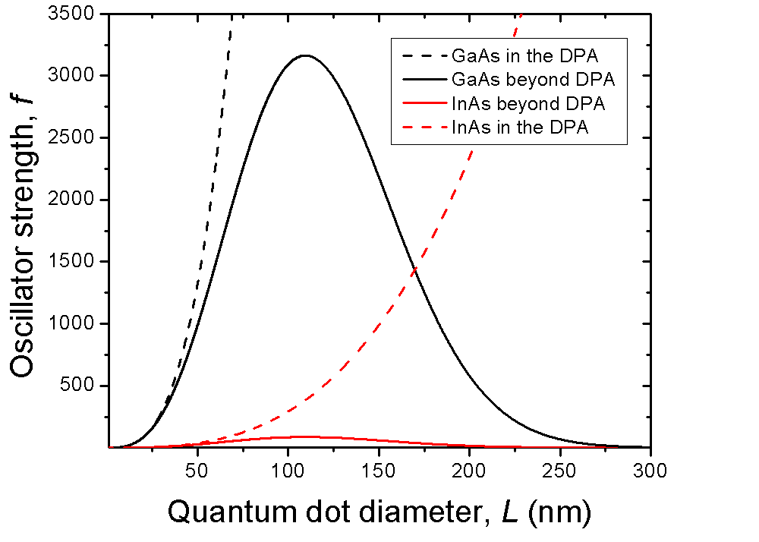

Huge oscillator strength
Spherical QD within the dipole approximation
Experimental evidence?
Notes:
Things change considerably when we investigate large QDs.

Slide 7
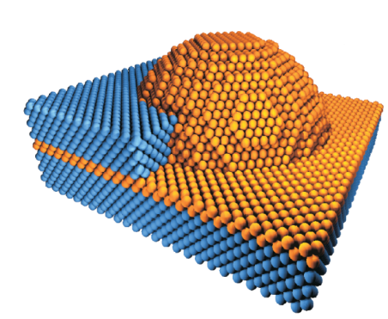
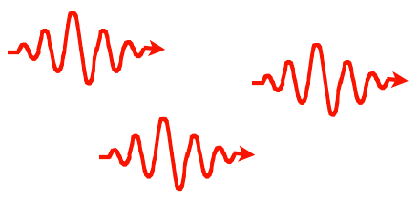

Quantifying light-matter interaction
Free space
e
Energy
h
Structured environment
GaAs
QD
WL
GaAs
Notes:
But before answering the first question, let us see how we can actually quantify light-matter interaction. The simplest way is to place an emitter in a homogeneous environment, excite it and let it relax back by spontaneously emitting a photon. The quicker it emits the photon, the stronger the QD interacts with light. The question is: does the decay rate depend on the environment? And the answer is: yes. In a structured environment, the radiative decay rate of the emitter is either enhanced or suppressed depending on the LDOS at the position of the emitter.

Slide 8
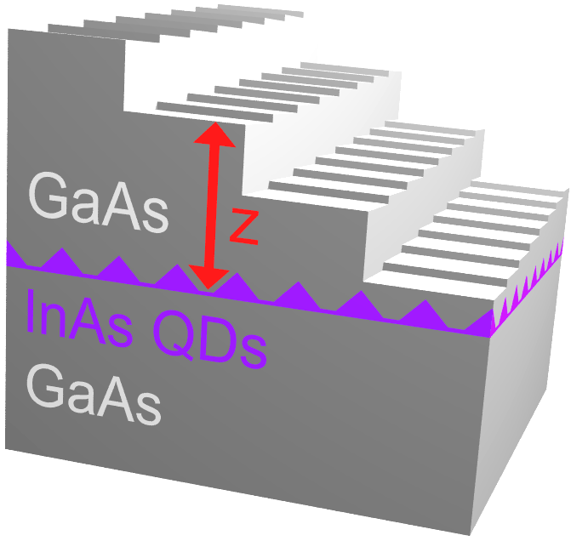


Interface as a spectroscopic tool
Measured decay rate
The rates are separated
Notes:
But before answering the first question, let us see how we can actually quantify light-matter interaction. The simplest way is to place an emitter in a homogeneous environment, excite it and let it relax back by spontaneously emitting a photon. The quicker it emits the photon, the stronger the QD interacts with light. The question is: does the decay rate depend on the environment? And the answer is: yes. In a structured environment, the radiative decay rate of the emitter is either enhanced or suppressed depending on the LDOS at the position of the emitter.

Slide 9
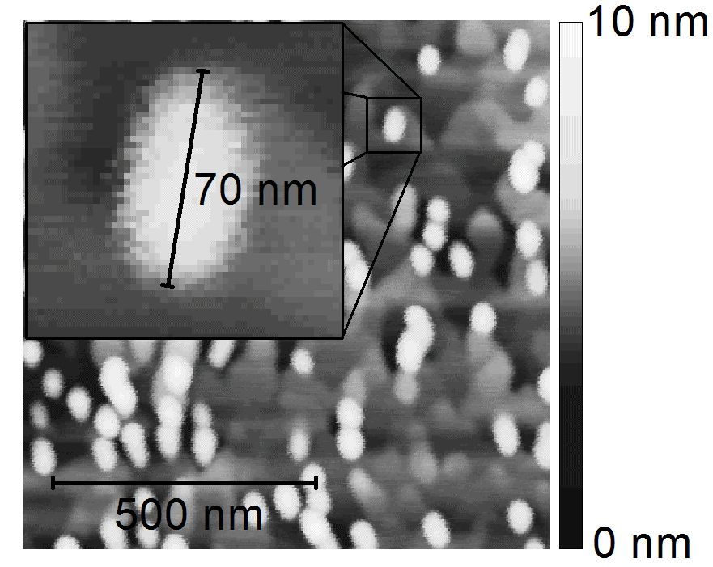
Large QDs with Small OS
Fast decay rate but small OS and low QE.
Reason? Strain effects, inhomogeneous material composition.
Future challenge.
Stobbe et al, PRB 82, 233302 (2010).

Slide 10
Outline of the talk
We will address two basic questions:
How strongly are QDs capable of coupling to the light field?
To which extent do QDs behave as point-like sources?
Notes:
Now let’s have a look at another consequence of the fact that QDs are extended emitters. Let’s see whether or not QDs behave like point sources.

Slide 11
Validity of the DA
n=1
λ₀=400 nm
a=0.5 nm
ka = 0.008 << 1
n=3.5
λ₀=900 nm
a=20 nm
ka = 0.5 ≈ 1

Slide 12
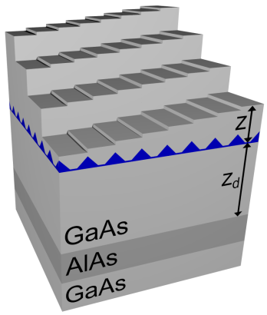
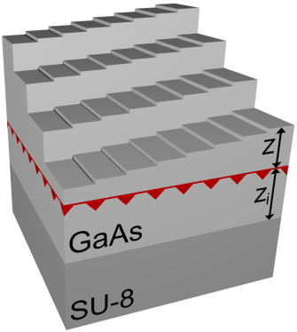
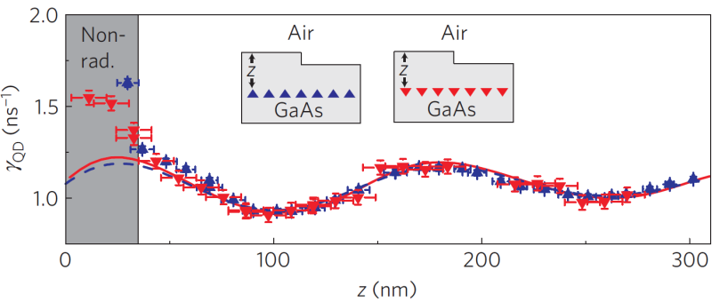
Breakdown of the DA: experiment
Andersen, Stobbe, Sørensen, and Lodahl, Nat. Phys. 7, 215 (2011).

Slide 13
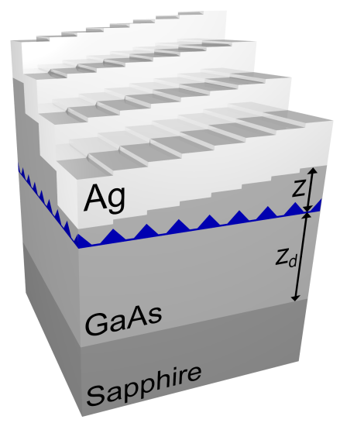
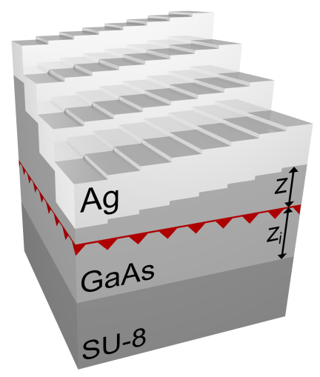
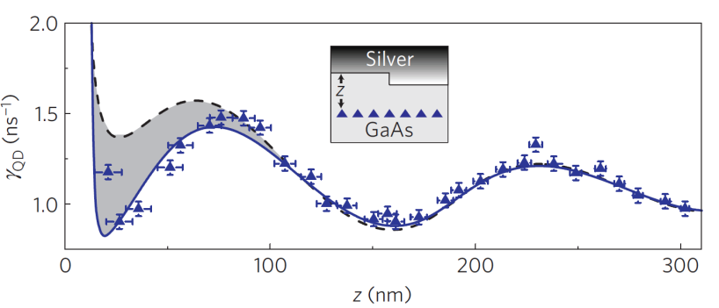
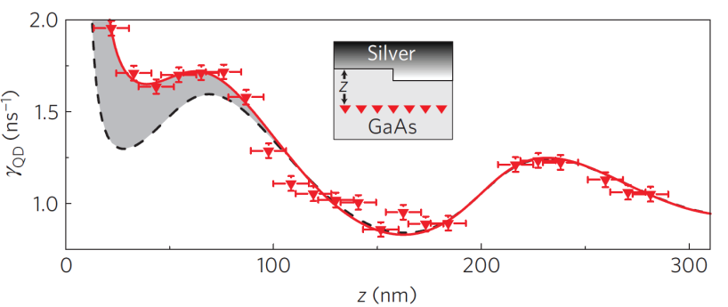
Breakdown of the DA: experiment
Andersen, Stobbe, Sørensen, and Lodahl, Nat. Phys. 7, 215 (2011).

Slide 14


Breakdown of DA: theory
Dipole approximation:
Beyond DA:
Light and matter degrees of freedom are no longer independent.
Decay dynamics are no longer determined by LDOS.

Slide 15


Future challenge
Theoretical computation within the envelope function approximation fails to reproduce experimental results.
In QDs translational symmetry is broken => EFA becomes questionable.
Future challenge to develop a self-consistent microscopic model.

Slide 16
Remember…
Large QDs have the potential of exhibiting huge coupling strength to light.
QDs are mesoscopic entities, NOT point dipoles.

